Slide 1
PRU Instruction Set
Arithmetic Operations (green)
Logic Operations (blue)
IO Operations (black)
Program Flow Control (red)
ADD | ADC | SUB | SUC | RSB
RSC | LSL | LSR | AND | OR
XOR | NOT | MIN | MAX | CLR
SET | LMBD | MOV | LDI | LDI32
LBBO | SBBO | LBCO | SBCO
JAL | JMP | CALL | (RET)
QBGT | QBGE | QBLT | QBLE | QBEQ
QBNE | QBA | QBBS | QBBC | WBS
WBC | HALT | SLP | MVIB | MVIW
MVID | ZERO | FILL | XIN, XOUT, | TSEN

Slide 2
Register Examples (1/2)
r0.b0
31
24
23
16
15
8
7
0
r0.b2
31
24
23
16
15
8
7
0
r0.w0
31
24
23
16
15
8
7
0
r0.w1
31
24
23
16
15
8
7
0

Slide 3
Register Examples (2/2)
There can be several ways to access the same set of bits
r0.t2
31
24
23
16
15
8
7
0
r0.w2.b1 = r0.b3
31
24
23
16
15
8
7
0
r0.w1.b1.t3 = r0.b2.t3 = r0.t19
31
24
23
16
15
8
7
0
r0.w2.t12 = r0.t28
31
24
23
16
15
8
7
0

Slide 4
Arithmetic Instructions
Operation:
  Perform unsigned 32-bit integer operation on two 32-bit zero-extended source values.
  Position the carry bit.
Format: <operation> Reg1, Reg2, OP(255)

Slide 5
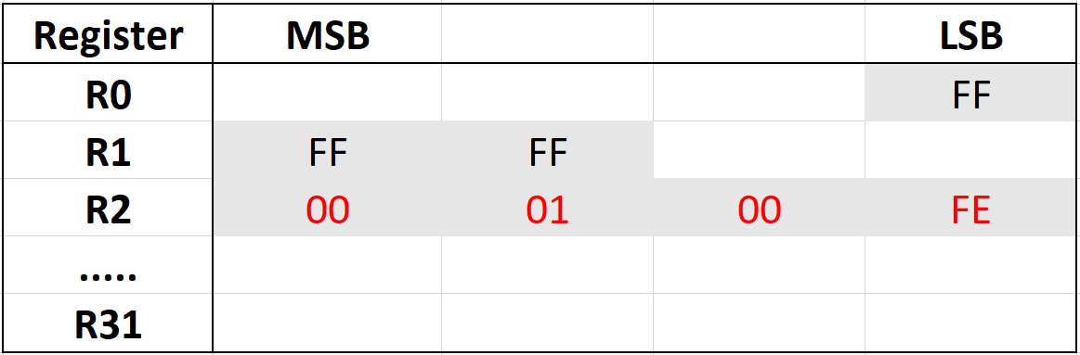
ADD
Format:
ADD Reg1, Reg2, OP(255) → IM(256)
Operation:
Reg1 = Reg2 + OP(255) →Either register field 8/16/32-bit or value 0-255
Example:
add r2, r0.b0, r1.w2
→ r2 = 01 00 FE
Note: If OP value > 255, it is NOT compiled and shows an error message

Slide 6
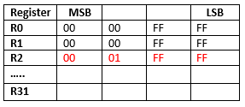
ADC = Add with carry
Format:
ADC Reg1, Reg2, OP(255)
Operation:
Reg1 = Reg2 + OP(255) + carry
carry = ((Reg2 + OP(255) + carry) >> bitwidth(Reg1)) & 1
Example:
adc r2, r0, r1 → r2 = 0001 FFFF
→ carry = 1
Note: If OP value > 255, it is NOT compiled and shows an error message

Slide 7
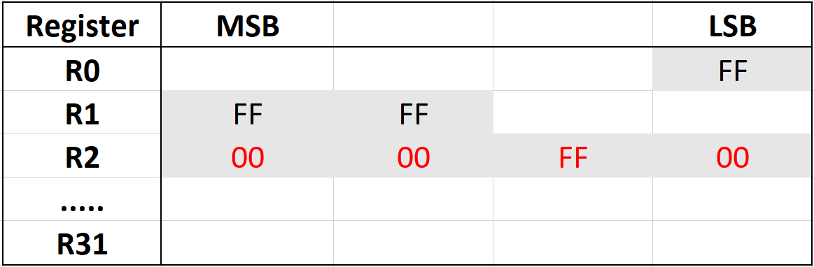
SUB = Subtract
Format:
SUB Reg1, Reg2, OP(255)
Operation:
Reg1 = Reg2 - OP(255)
Example:
sub r2, r1.w2, r0.b0
→ r2 = 0000 FF00
Note: If OP value > 255, it is NOT compiled and shows an error message

Slide 8
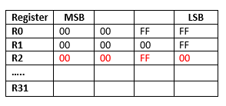
RSB = Reversed Integer Subtract
Format:
RSB Reg1, Reg2, OP(255)
Operation:
Reg1 = OP(255) - Reg2
Example:
rsb r2, r1, r0
→ r2 = 0000 FF00
Note: If OP value > 255, it is NOT compiled and shows an error message

Slide 9
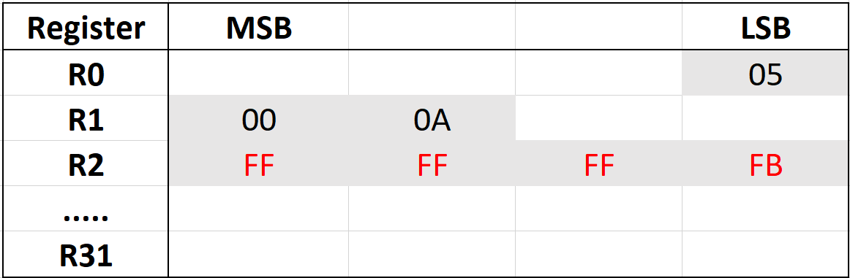
SUC = Subtract with Carry
Format:
SUC Reg1, Reg2, OP(255)
Operation:
Reg1 = Reg2 - OP(255) - carry
carry = ((Reg2 - OP(255) - carry) >> bitwidth(Reg1)) & 1
Example:
suc r3, r0.b0, r1.w2
→ carry = FFFF FFFF
Note: If OP value > 255, it is NOT compiled and shows an error message

Slide 10
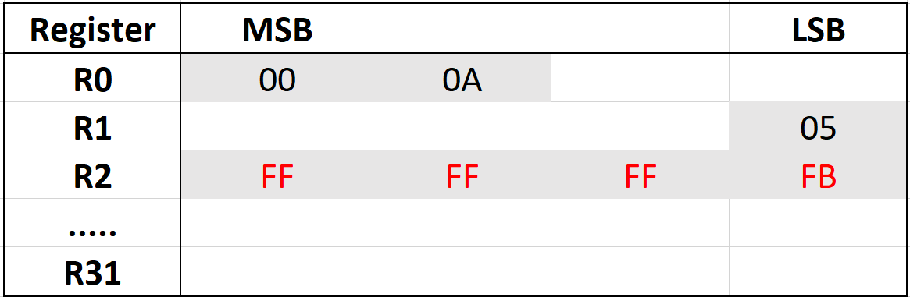
RSC = Reversed Integer Subtract with Carry
Format:
RSC Reg1, Reg2, OP(255)
Operation:
Reg1 = OP(255) - Reg2 - carry
carry = ((OP(255) - Reg2 - carry) >> bitwidth(Reg1)) & 1
Example:
rsc r2, r0.w2, r1.b0
Note: If OP value > 255, it is NOT compiled and shows an error message

Slide 11
Logic Operations
Operation:
  Perform 32-bit logical operation on two 32-bit zero-extended source values.
Format: <operation> Reg1, Reg2, OP()
→ OP() can be OP(255) or OP(31), depending on the instruction

Slide 12
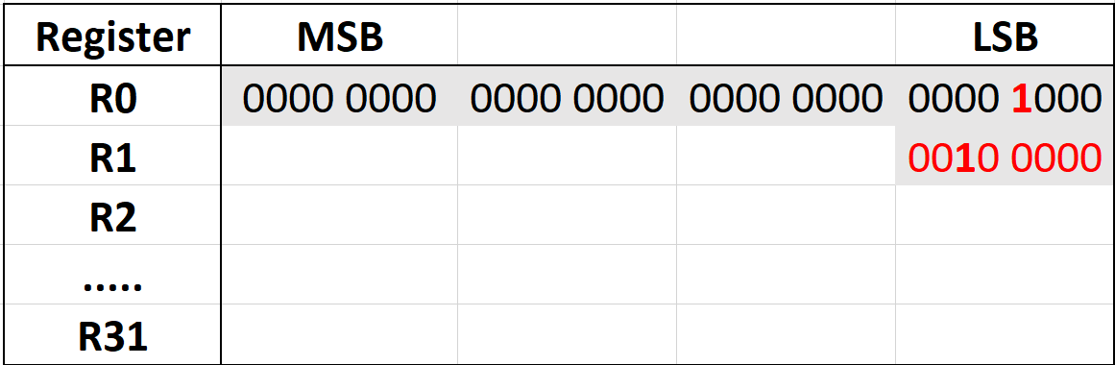
LSL = Logical Shift Left
Format:
LSL Reg1, Reg2, OP(31)
Example:
lsl r1.b0, r1, 2 → r1 << 2 (bit)
lsl r2, r2.b0, r1.b1
Note: If OP>31 wraps around to zero

Slide 13
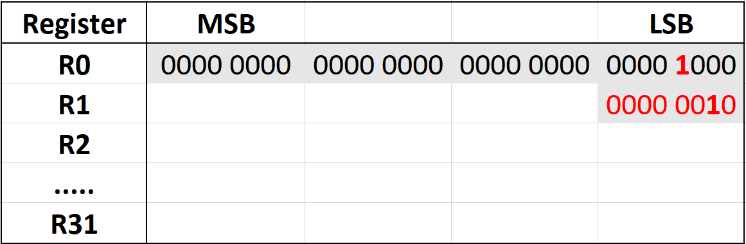
LSR = Logical Shift Right
Format:
LSR Reg1, Reg2, OP(31)
Example:
lsr r1, r1, 2 → r1 >> 2
lsr r2, r2.b0, r1.b1
Note: If OP>31 it just starts back from 0

Slide 14
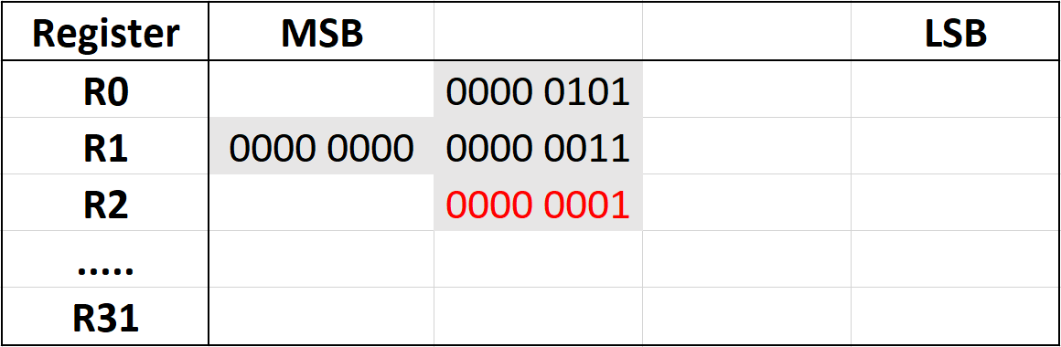
AND
Format:
AND Reg1, Reg2, OP(255)
Operation:
Reg1 = Reg2 & OP(255)
Example:
and r2, r0.b2, r1.w2
and r2, r0.b2, 3
Note: If OP>255 it just starts back from 0

Slide 15
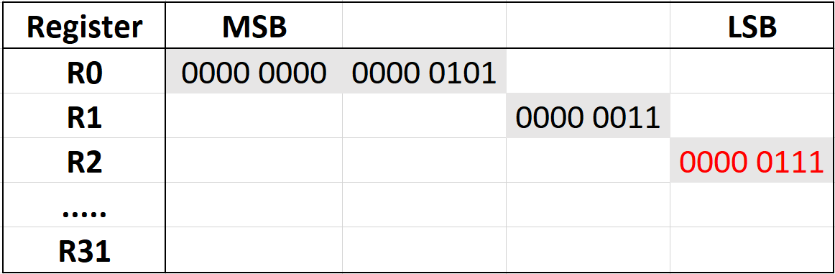
OR
Format:
OR Reg1, Reg2, OP(255)
Operation:
Reg1 = Reg2 | OP(255)
Example:
or r2, r1.b1, r0.w2
or r2, r1.b1, 3
Note: If OP>255 it just starts back from 0

Slide 16
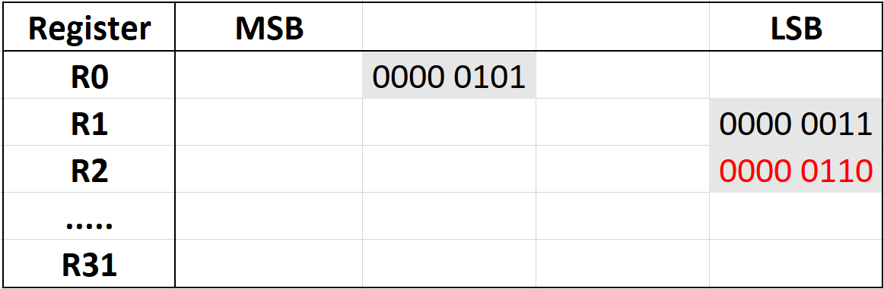
XOR
Format:
XOR Reg1, Reg2, OP(255)
Operation:
Reg1 = Reg2 ^ OP(255)
Example:
xor r2, r1.b0, r0.b2
xor r2, r1.b0, 3
Note: If OP>255 it just starts back from 0

Slide 17
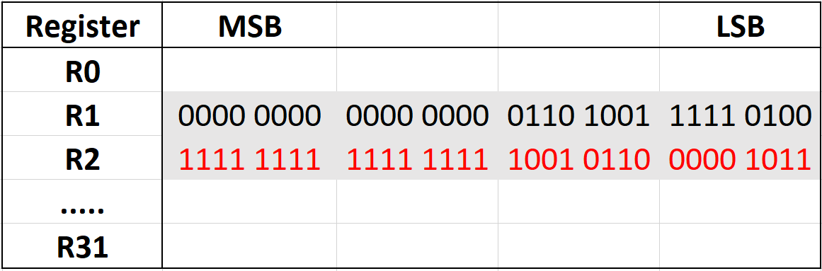
NOT
Format:
NOT Reg1, Reg2
Operation:
Reg1 = ~ Reg2
Example:
not r2, r1
Note: If R2 > 65535 an error message occurs, same for negative values

Slide 18
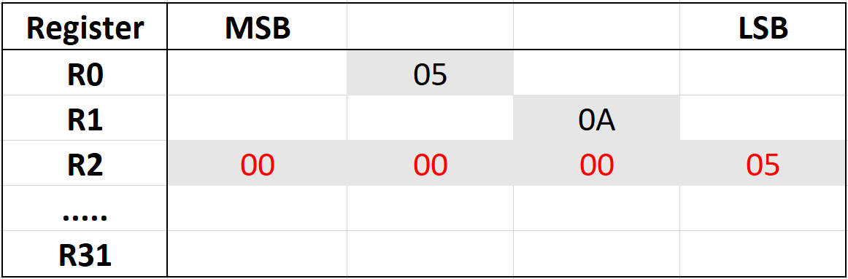
MIN
Format:
MIN Reg1, Reg2, OP(255)
Operation:
if (OP(255) > Reg2)
Reg1 = Reg2;
else
Reg1 = OP(255);
Example:
min r2, r1, r0
Note: If OP>255 it is not compiling → error message

Slide 19
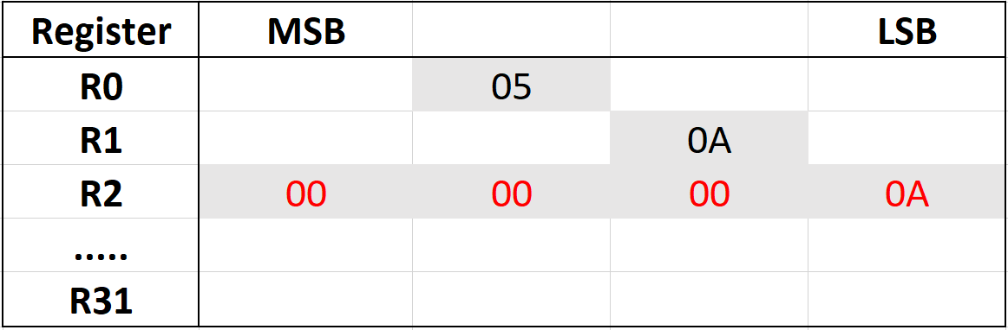
MAX
Format:
MAX Reg1, Reg2, OP(31)
Operation:
if (OP(255) > Reg2)
Reg1 = OP(255);
else
Reg1 = Reg2;
Example:
max r2, r1, r0
Note: If OP>255 it is not compiling → error message

Slide 20
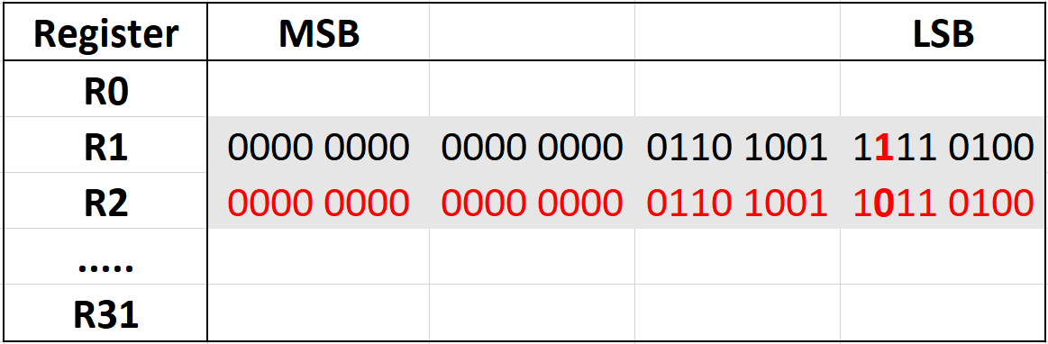
CLR – Clear Bit
Format:
CLR Reg1, Reg2, OP(31)
Example:
clr r2, r1, r0 (=6)
clr r2, r1.b0, r1.b1
clr r2, r1, 6
Note: If OP>31 it starts from 0 again

Slide 21
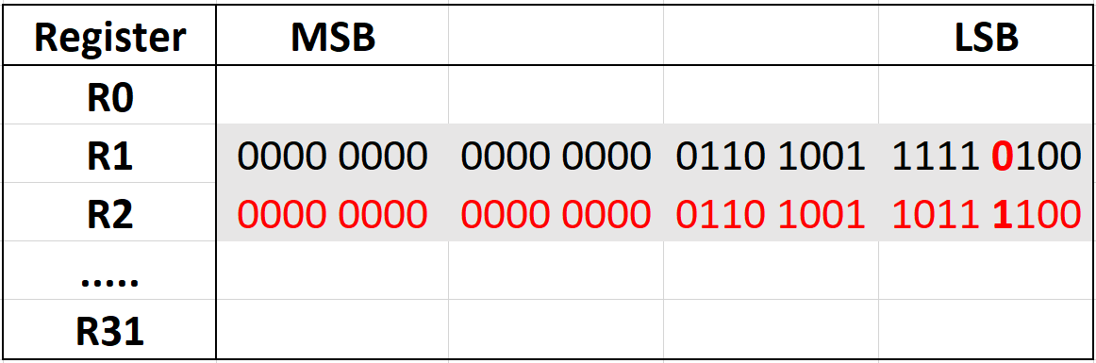
SET – Set Bit
Format:
SET Reg1, Reg2, OP(31)
Example:
set r2, r1, r0 (=3)
set r2, r1, 3
set r2, r1.b0, r1.b1
Note: If OP>31 it starts from 0 again

Slide 22
LMBD – Left Most Bit Detect
Format:
LMBD Reg1, Reg2, OP(255)
Operation:
Searches Bit position in Reg2 of OP(255)
Example:
lmbd r3, r1, 0/1
lmbd r3, r1, r2 (=0/1)
For OP(255) = {0, 2, 4, 6 .... 254} it always looks for the most left 0
For OP(255) = {1, 3, 5, 7 .... 255} it always looks for the most left 1
Note: If OP>255 it is not compiling → error message

Slide 23
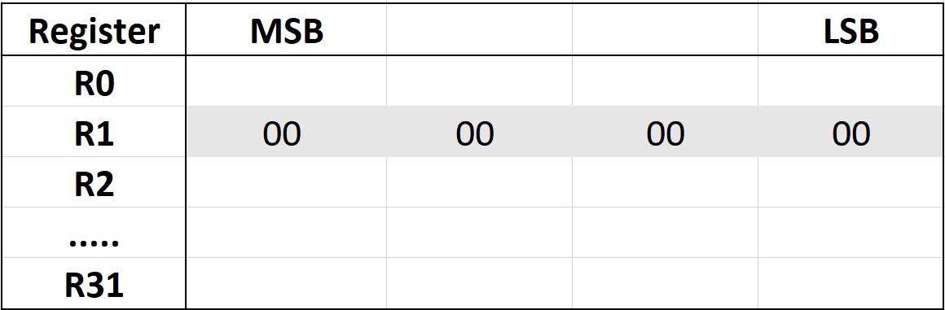
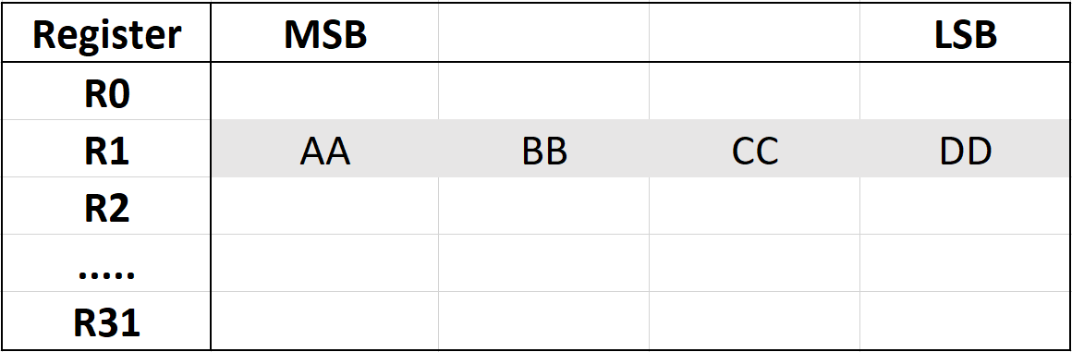
LDI = Load Immediate
Format: The LDI instruction moves the value from IM(65535), zero extends it, and stores it into REG1
LDI Reg1, IM(65535)
Operation:
Reg1 = IM(65535)
Example:
ldi32 r1, 0xaabbccdd
ldi r30.b0, &r2
Before
After
Note: If IM>65535 it shows error message

Slide 24
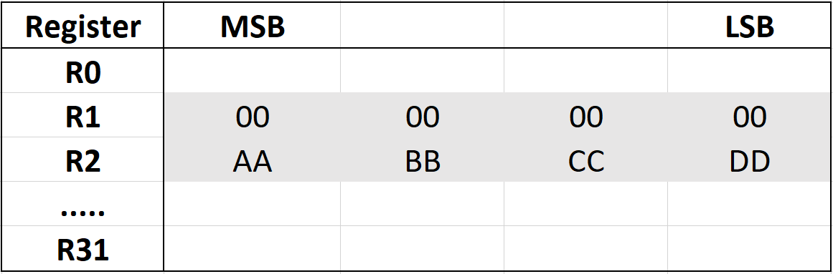
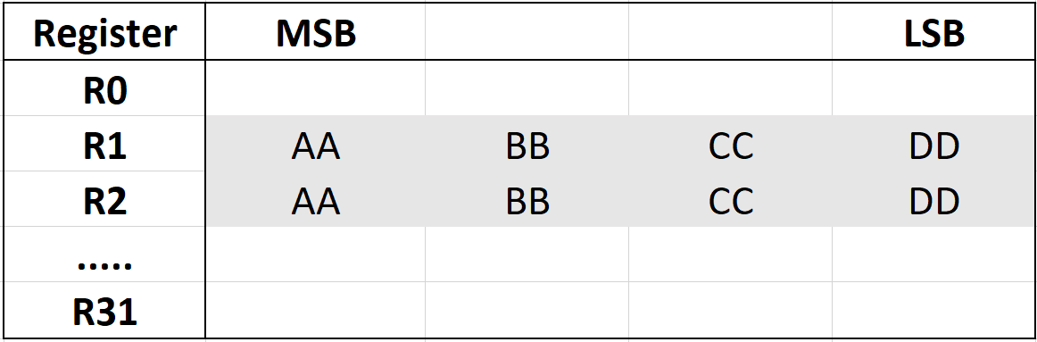
MOV = Copy Value
Format: The MOV instruction moves the value from REG2 and stores it into REG1
MOV Reg1, Reg2
Operation:
Reg1 = Reg2
Example:
mov r1, r2
mov r1.b1, r1.b3
mov r1.b1, r1.w2
Before
After

Slide 25
MVIx = Move Register File Indirect
Format: MVIB/W/D moves an 8- (B) /16- (W) or 32-bit (D) value from Source to Destination
MVIx [*][&][--]REG1[++], [*][&][--]REG2[++] [, bn]
Example 1:
MVIW R2.W0 (2 byte), *R1.B3
PRU registers file (hex)
Before:
After:
R0
R1
R2
55 | AA | 55 | AA
03 | 02 | 01 | 00
FF | FF | FF | FF
R0
R1
R2
55 | AA | 55 | AA
03 | 02 | 01 | 00
FF | FF | 00 | 55
Indicates an offset of 3 bytes
Note: If value > 128 for pointer, then it starts from 0 again

Slide 26
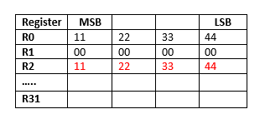
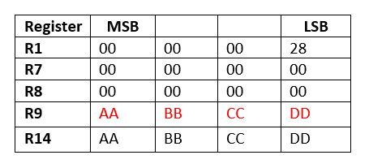
MVIx = Move Register File Indirect
Example 2:
MVID R2, *R1.B0++
After the execution, R1.B0 changes from 00 to 04
Example 3:
MVID *--R1.B0, R14
After the execution R1.B0 decrements from 28h to 24h
Example 4: Invalid instruction
MVID *--R1.B0, *R14

Slide 27
SBBO/LBBO = Store/Load Byte Burst
LBBO/SBBO is used to read/write a block of data from memory into the register file
Format:
LBBO/SBBO Source (&Reg1), Destination (Reg2), Offset, Length
Examples:
lbbo &r2, r1, 5, 8 // Copy 8 bytes into r2/r3 from the memory address r1+5
sbbo &r2, r1, 256, 129 // Error: Offset must be <256, Length must be <129
PRU registers file
MSB LSB
System memory
R0
R1
R2
R3
R4
2 | 1 | 0
6 | 5 | 4 | 3
 |  |  | 7
SBBO &R1.b1, R29, 0/5, 8
0x03020100
0x07060504
@ 0x6651B000/5
@ 0x6651B004
LBBO &R1.b1, R29, 0, 8
…..
R29
R30
R31
0x6651B000

Slide 28
SBCO/LBCO – Store/Load Byte Burst with Constant Table Offset
Example:
lbco &r2, c1, 5, 8 // Copy 8 bytes into r2/r3 from the
// memory address c1+5
lbco &r3, c1, r2.w0, b0 // Copy "r0.b0" bytes into r3 from the
// memory address c1+r2.w0
sbco &r2, c1, 5, 8 // Copy 8 bytes from r2/r3 to the
// memory address c1+5
sbco &r3, c1, r2.w0, b0 // Copy "r0.b0" bytes from r3 to the
// memory address c1+r2.w0
Note: Same limitations as in LBBO/SBBO

Slide 29
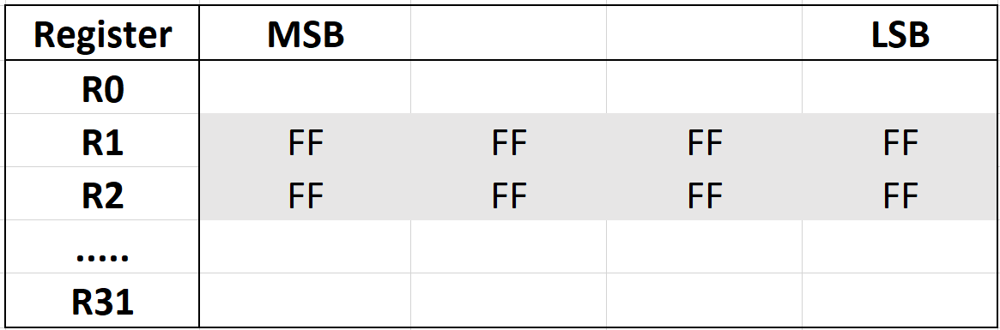
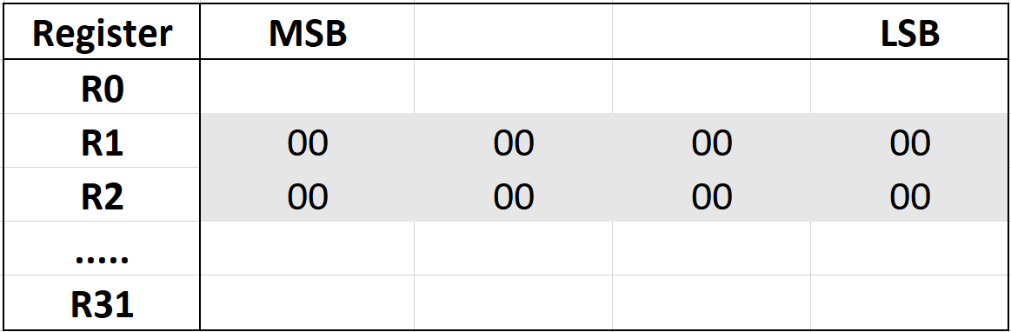
ZERO
Format:
ZERO &REG1, IM(128)
ZERO IM(123), IM(128) // Invalid Instruction!
Example:
zero &r0, 8 (bytes) // Set R0 and R1 to zero
zero 0, 8 // Invalid Instruction
Before
After
Note: Error if value is >128 for second value

Slide 30
JMP = Unconditional Jump
Unconditional jump to a 16-bit instruction address, specified by register or immediate value. Also works with label, jmp loop1, main etc.
Definition:
JMP OP(65535)
Operation:
PRU Instruction Pointer = OP(65535)
Example:
jmp r2.w0 // Jump to instruction number r2.w0
r2.w0 = 1 → Program Counter PC = 4 x 1 = 4
r2.w0 = 4 → Program Counter PC = 4 x 4 = 16
One instruction is 4 bytes

Slide 31
JAL = Unconditional Jump and Link
Unconditional jump to a 16-bit instruction address, specified by register or immediate value. The address following the JAL instruction is stored into REG1, so that REG1 can later be used as a "return" address
Definition
JAL REG1, OP(65535)
Operation
REG1 = Current PRU Instruction Pointer + 1 PRU
Instruction Pointer = OP(65535)
Example
jal r2.w2, r2.w0 // Jump to the address stored in r2.w0 // put return location in r2.w2

Slide 32
QBGT/QBGE = Quick Branch if Greater Than or Equal
Definition: QBGT/E LABEL, REG1, OP(255)
Example:
qbge myLabel, r2.w0, 5 // Branch to label if 5 > r2.w0
qbge myLabel, r3, r4 // Branch to label if r4 > r3
qbgt myLabel, r2.w0, 5 // Branch if 5 >= r2.w0
qbgt myLabel, r3, r4 // Branch if r4 >= r

Slide 33
QBLT/E= Quick Branch if Less Than or Equal
Definition: QBLT LABEL, REG1, OP(255)
Example:
qblt myLabel, r2.w0, 5 // Branch if 5 < r2.w0
qblt myLabel, r3, r4 // Branch if r4 < r3
qble myLabel, r2.w0, 5 // Branch if 5 <= r2.w0 qble myLabel, r3, r4 // Branch if r4 <= r3

Slide 34
QBEQ= Quick Branch if Equal
Definition: QBEQ LABEL, REG1, OP(255)
Operation: Branch to LABEL if OP(255) == REG1
Example:
qbeq myLabel, r2.w0, 5 // Branch if r2.w0==5
qbeq myLabel, r3, r4 // Branch if r4==r3

Slide 35
QBNE = Quick Branch if Not Equal
Definition: QBNE LABEL, REG1, OP(255)
Operation: Branch to LABEL if OP(255) != REG1
Example:
qbne myLabel, r2.w0, 5 // Branch if r2.w0!=5
qbne myLabel, r3, r4 // Branch if r4!=r3

Slide 36
QBA = Quick Branch Always
Jump always. This is similar to the JMP instruction, only QBA uses an address offset and thus can be relocated in memory
Example:
qba myLabel // Branch
→ Limit wie weit man springen kann? Label wie weit weg?

Slide 37
QBBS = Quick Branch if Bit is Set
Definition: QBBS LABEL, REG1, OP(31)
Operation: Branch to LABEL if (REG1 & (1 << (OP(31) & 0x1f)))
Example:
qbbs myLabel r3, r1 // Branch if (r3 & (1<<r1))
qbbs myLabel, r1.b1, 5 // Branch if (r1.b1 & 1<<5)
OR
Definition: QBBS LABEL, Rn.tx
Operation: Branch to LABEL if( Rn & Rn.tx )
Example:
qbbs myLabel, r1.b1.t5 // Branch if (r1.b1 & 1<<5)
qbbs myLabel, r0.t0 // Branch if bit 0 in R0 is set

Slide 38
QBBC = Quick Branch if Bit is Clear
Definition: QBBC LABEL, REG1, OP(31)
Operation: Branch to LABEL if ( !(REG1 & (1 << (OP(31) & 0x1f)))
Example:
qbbc myLabel r3, r1 // Branch if ( !(r3 & (1<<r1))
qbbc myLabel, r1.b1, 5 // Branch if ( !(r1.b1 & 1<<5))
OR
Definition: QBBC LABEL, Rn.tx
Operation: Branch to LABEL if ( !(Rn & Rn.tx))
Example:
qbbc myLabel, r1.b1.t5 // Branch if ( !(r1.b1 & 1<<5))
qbbc myLabel, r0.t0 // Branch if bit 0 in R0 is set

Slide 39
WBS/C = Wait until Bit Set/Clear
Instruction waits until Bit is Set or Cleared (see Slide 20/21)
Definition: WBS REG1, OP(31)
Operation: QBBS/C $, REG1, OP(31)
Example:
wbs/c r31, r1
wbs/c r31.b1, 5
Note: REG1 is almost certainly R31, else this instruction could lead to an infinite loop

Slide 40
HALT = Halt Operation
This Operation is used to halt the PRU and implement SW breakpoints in the debugger
The Program counter remains in the current location
When the PRU is reenabled the instructions is refetched from instruction memory
Example
halt

Slide 41
SLP = Sleep Operation
The SLP instruction will sleep the PRU. This instruction can specify either a permanent sleep or a "wake on event". When the wake on event option is set to "1", the PRU will wake on any event that is enabled in the PRU Wakeup Enable register. Otherwise, the core can only be woken by manually clearing the SLEEPING bit of the core's CTRL register, or by resetting the PRU core.
Example
SLP 0 // Sleep without wake events
SLP 1 // Sleep until wake event set

Slide 42
LOOP = Hardware Loop Assist
Defines a hardware-assisted loop operation. The loop is non interruptible.
Example 1:
loop EndLoop, 5 // Peform the loop 5 times
mvi r2, *r1.b0 // Get value
xor r2, r2, r3 // Change value
mvi *r1.b0++, r1 // Save value
EndLoop:
Example 2:
mvi r2, *r1.b0++ // Get the number of elements
loop EndLoop, r2 // Peform the loop for each element (value of r2)
mvi r2, *r1.b0 // Get value
call ProcessValue // It is legal to jump outside the loop
mvi *r1.b0++, r1 // Save value
EndLoop:
Note: When the loop count is set from a register, only the 16 LSB are used (regardless of the field size). If this 16-bit value is zero, the instruction jumps directly to the end of loop

